Slide 1
FoodHub Data Analysis
Project Foundations for Data Science
Shreya Saxena
6/15/24

Slide 2
Contents / Agenda
Executive Summary
Business Problem Overview and Solution Approach
Data Overview
Univariate Analysis
Multivariate Analysis

Slide 3
Executive Summary
Conclusions
Cuisines such as American, Japanese, Italian, and Chinese are most frequently ordered from, therefore they have higher demand
The more popular the restaurant is, the more expensive it seems to be
Most ratings are 4 and above, indicating decent customer satisfaction. However, there are many orders that were not rated
Customers are either not rating or rate a 5 when the delivery is fast. However, customers are more likely to give a lower rating when the delivery time is slow
Majority of the orders costed between $10-$30. However, there were a few that were above $50. This suggests there are customers with different budgets on this app
The restaurants and delivery people are working efficiently since the average delivery time is decent
There are quite a few customers that places orders with us again and again, indicating good customer experience
Restaurants seem to be working faster when they have more orders on the weekends

Slide 4
Executive Summary
Recommendations
Become business partners with popular cuisines which can potentially attract more customers and orders from the app
Work with low rated restaurants to improve their quality, which can attract more customers that prefer that cuisine, increasing sales
Give promotions to restaurants on the app that seem to be thriving so more orders are placed with increased customer satisfaction
implement ideas on encouraging more feedback after a customer receives their order so it is more easier to identify where improvement is needed
Create an incentive, such as an loyalty points program, to have more repeating customers

Slide 5
Business Problem Overview and Solution Approach
Background:
Online food delivery has been growing popular among students and busy adult lives. The FoodHub app allows people to order their favorite food, which arrives at a swift speed by an a deliverer, who earns money through this job, and lets the customer rate their experience.
Problem Overview:
We have data of multiple different orders made by customers through FoodHub. The objective is to analyze the vast amount data to enhance customer experience.
Solution approach / methodology
Become business partners with popular cuisines
Work with low rated restaurants to improve their quality
Give promotions to restaurants
implement ideas on encouraging more feedback
Create an incentive, such as an loyalty points program

Slide 6
Data Overview
The data includes order ID, customer ID, restaurant name, cuisine type, cost of the order, day of the week, rating, food preparation time, and delivery time.
There are 1898 rows and 9 columns present in this dataset
Datatypes of each column
Order ID: Integer
Customer ID: Integer
Restaurant name: Object
Cuisine type: Object
Cost of the order: Float
Day of the week: Object
Rating: Object
Food preparation time: Integer
Delivery time: Integer
There are no missing values in the data

Slide 7
Data Overview
Statistical summary for the time it takes for food to be prepared once an order is placed
Minimum: 20 minutes
Average: 27.37 minutes
Maximum: 35 minutes
736 orders were not rated

Slide 8
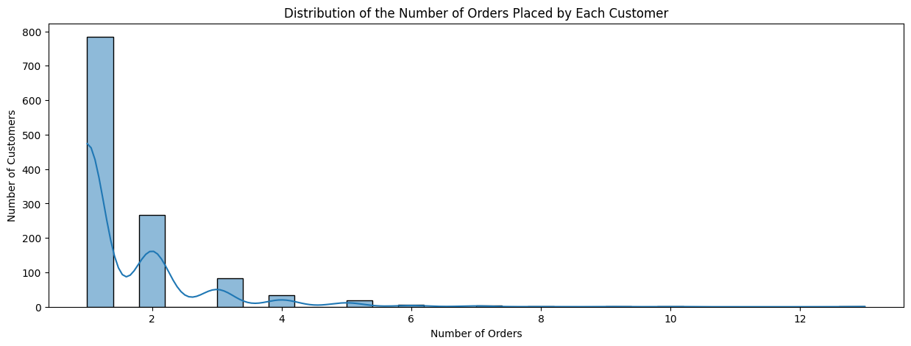
Univariate Analysis
Order ID
contains unique values/identifiers representing a different order
Customer ID
contains unique values identifying each customer placing the order
a little less than 800 customers only places order once
about 300 customers place orders twice
about a 100 customers were frequent and places orders more than 4 times
the distribution is skewed to the right

Slide 9
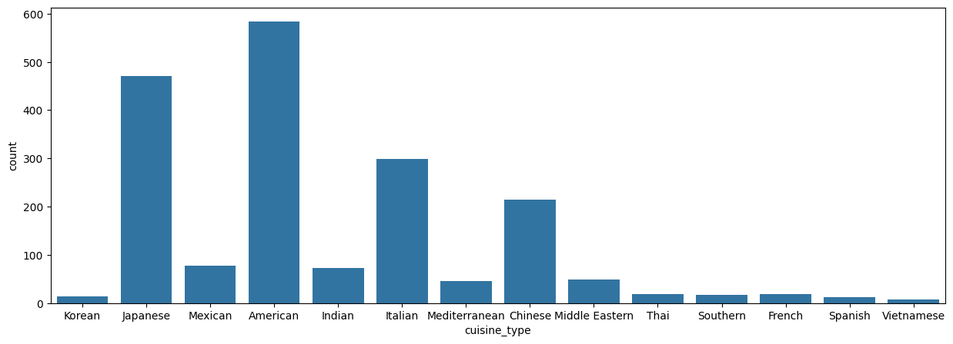
Univariate Analysis
Restaurant name
multiple restaurants names indicating from which place the customer ordered from
Cuisine type
indicates the type of cuisine ordered
American, Japanese, Italian, and Chinese are most frequently ordered
Vietnamese, Spanish, French, SOuthers, Thai, and Korean are least frequently ordered

Slide 10
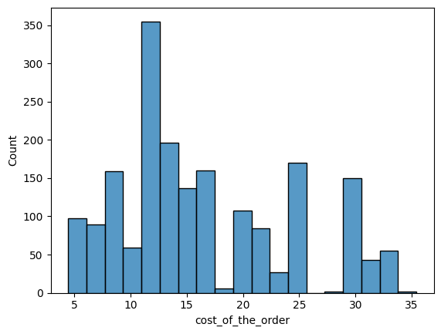
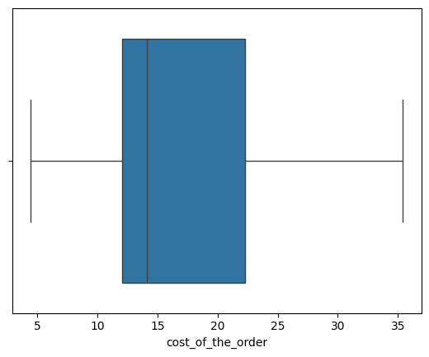
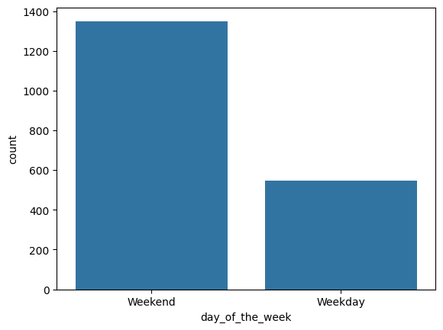
Univariate Analysis
Cost of the order
indicated the cost of each order
25% of the orders are $5-$12
Another 25% of the orders are $23-$35
50% of the orders are between $12-$23
the median is about 14 minutes
the distribution is skewed a little to the right
Day of the week
indicates whether a order was placed on a weekday or weekend
About 13500 orders were placed on a weekend
About 550 orders were placed on a weekday

Slide 11
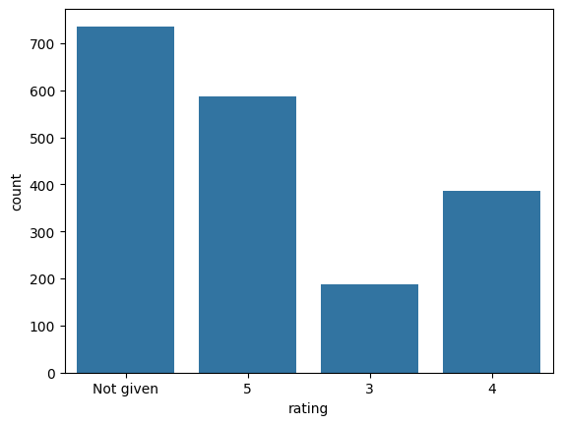
Univariate Analysis
Rating
customers rate their experience ordering from FoodHub on a scale from 1 to 5
most customers did not give a rating
the highest to lowest total ratings given was: 5, 4, 3

Slide 12
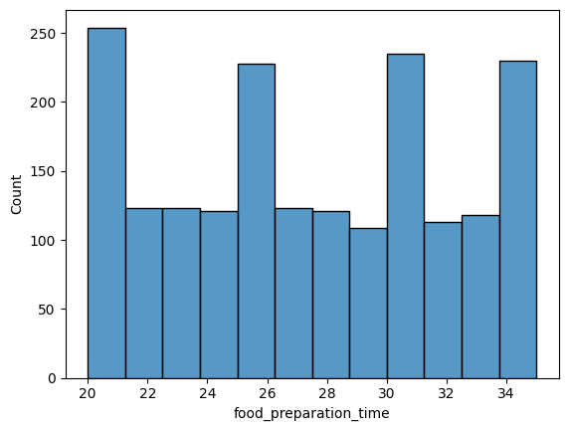
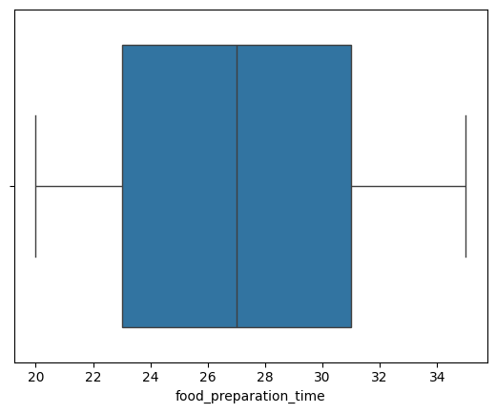
Univariate Analysis
Food preparation time
indicates time taken for the order to be prepared by the restaurant
it took 23-31 minutes 50% of the time for the food to be prepared
it took 20-23 minutes 25% of the time for the food to be prepared
the other 25% of the time, it took 31-35 minutes for the food to be prepared
the median is about 27 minutes

Slide 13
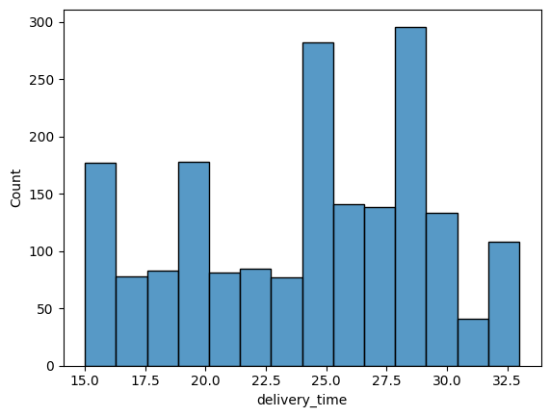
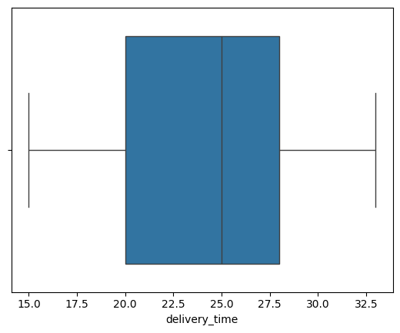
Univariate Analysis
Delivery time
indicates the time taken by the delivery person to deliver the food
it took 20-28 minutes 50% of the time for the food to be delivered
it took 15-20 minutes 25% of the time for the food to be delivered
it took 28-33 minutes 25% of the time for the food to be delivered
the median is 25 minutes

Slide 14
Univariate Analysis
Top 5 restaurant in terms of the number of orders received
Shake Shack: 219 orders received
The Meatball Shop: 132 orders received
Blue Ribbon Sushi: 119 orders received
Blue Ribbon Fried Chicken: 96 orders received
Parm: 68 orders received
American is the most popular cuisine on the weekends
555 orders, which is 29.24% cost above $20
The mean/average delivery time is 24.16 minutes
If the company were to give 20% discount vouchers to the top 3 most frequent customers, they would be
52832 ID: 13 orders
47440 ID: 10 orders
83287 ID: 9 orders

Slide 15
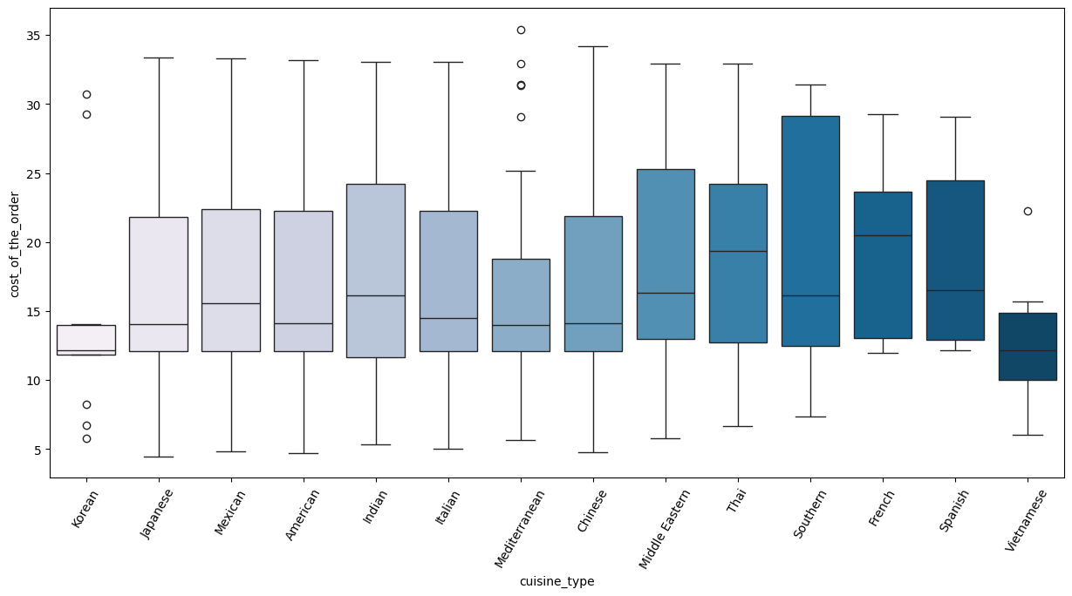
Multivariate Analysis
Cuisine vs Cost of the order
there are outliers for korean, mediterranean, and vietnamese cuisine types vs cost of the order
Southern cuisine had the most wide range of cost of their orders
Korean cuisine had the lease wide range of cost of their orders
Vietnamese seems to have the cheapest orders

Slide 16
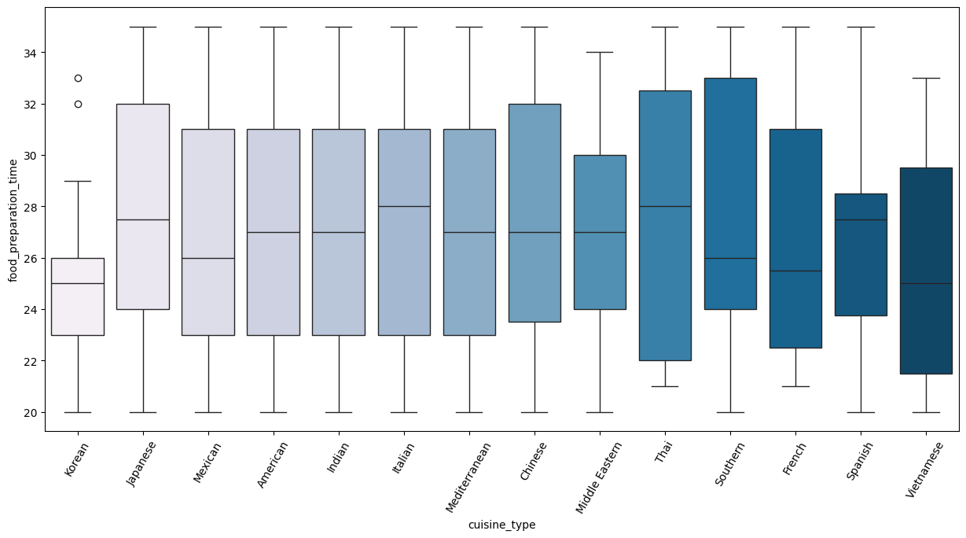
Multivariate Analysis
Cuisine vs Food Preparation time
korean cuisine is most likely to take the least amount of time to be prepared
thai cuisine has the widest range, so it is the hardest to tell whether a order will be fast or slow
the median time for all cuisine are about an average of 27 minutes
there are outliers in the korean cuisine
the minimum is usually 20 minutes and the maximum is usually 35 minutes for all cuisine types

Slide 17
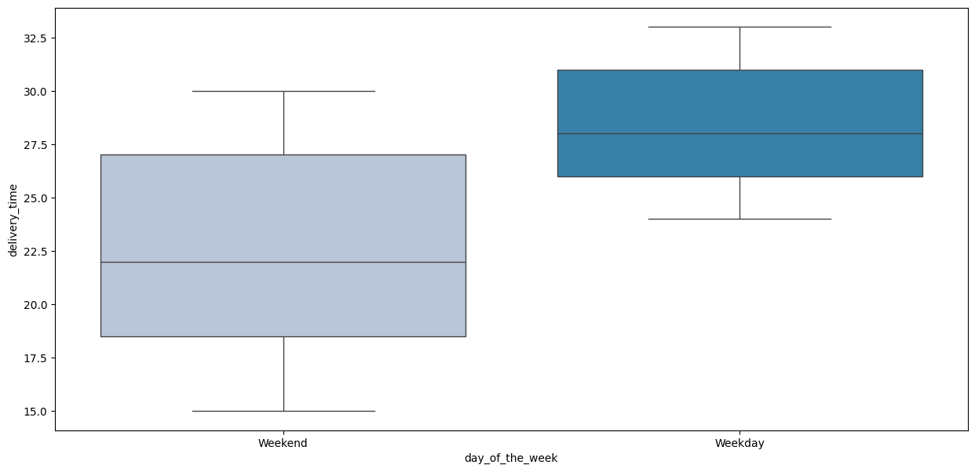
Multivariate Analysis
Day of the Week vs Delivery time
weekdays typically have a faster delivery time than weekends
weekdays
it takes 15-18 minutes of delivery time 25% of the time
it takes 18-27 minutes of delivery time 50% of the time
it takes 27-30 minutes of delivery time 25% of the time
weekends
it takes 25-26 minutes of delivery time 25% of the time
it takes 26-31 minutes of delivery time 50% of the time
it takes 31-33 minutes of delivery time 25% of the time

Slide 18
Multivariate Analysis
Observations on the revenue generated by the restaurants
Shake Shack has the highest revenue of $3579.53, indicating popularity
The meatball shop and Blue Ribbon Sushi have the second/third highest revenue of $2145.21 and $1903.95, indicating they are still popular even though they have less orders than Shake Shack
There is a drop in revenue as you go down the table with Blue Ribbon being fourth with a revenue of $1662.29
Parm has a revenue of $1112.76, which makes the fifth highest revenue
TOA, Han Dynasty, Blue Ribbon Sushi Bar & Grill, Rubirosa, Sushi of Gari 46, and Nobu Next Door revenues range from $834.5 to $623.67, which indicate they are mid-tier
Five Guys Burgers and Fries has the lowest revenue of $506.47, indicating the lowest popularity

Slide 19
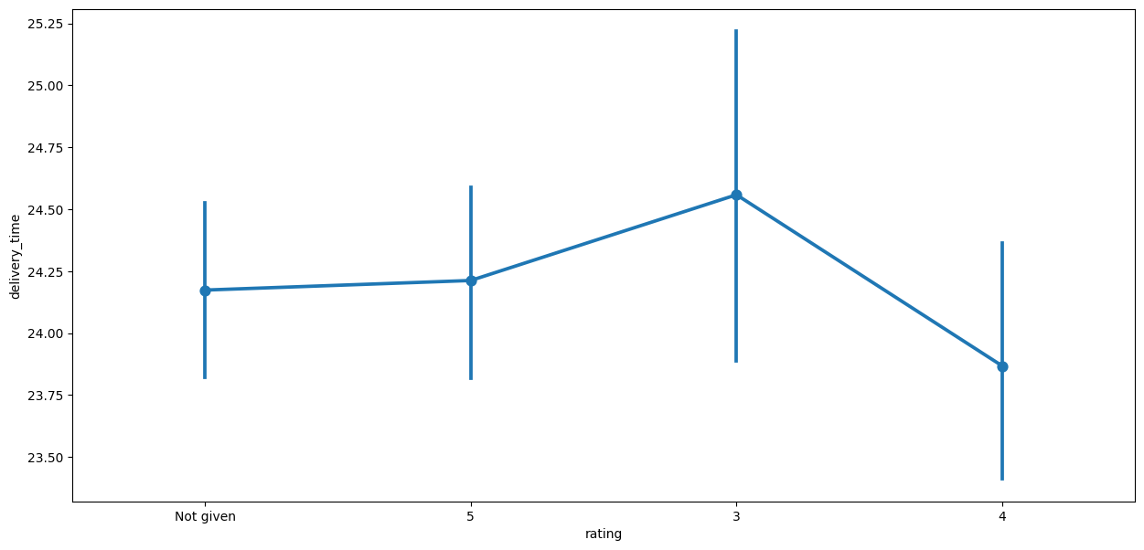
Multivariate Analysis
Rating vs Delivery time
no given rating: mean delivery time around 24.25 minutes. Range from about 24.00 to 24.50 minutes.
rating 5: mean delivery time slightly above 24.25 minutes. Range from about 24.00 to 24.50 minutes.
rating 3: mean delivery time around 24.75 minutes. Wider range from about 24.00 to 25.25 minutes.
rating 4: mean delivery time slightly below 24.25 minutes. Range from about 23.75 to 24.75 minutes.

Slide 20
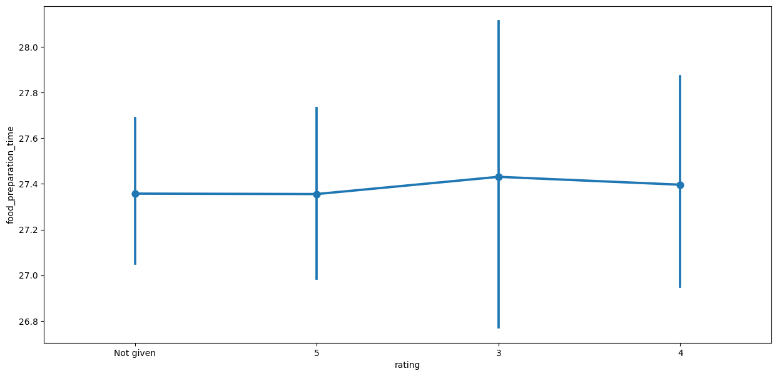
Multivariate Analysis
Rating vs Food preparation time
no given rating: mean preparation time around 27.4 minutes with some variability
rating 5: mean preparation time around 27.4 minutes
rating 3: mean preparation time slightly above 27.4 minutes with a wider range of variability
rating 4: mean preparation time around 27.4 minutes with some variability

Slide 21
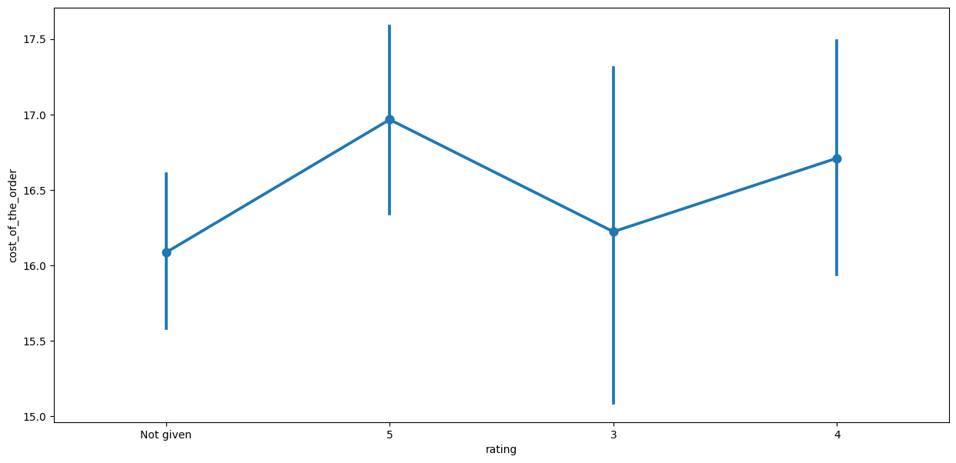
Multivariate Analysis
Rating vs Cost of the order
no given rating: mean cost around $16. Range from about $15.5-$16.5
rating 5: mean cost around $17. Range from about $16-$18
rating 3: mean cost around $16.5. Range from about $15-$18
rating 4: mean cost around $17. Range from about $16-$18

Slide 22
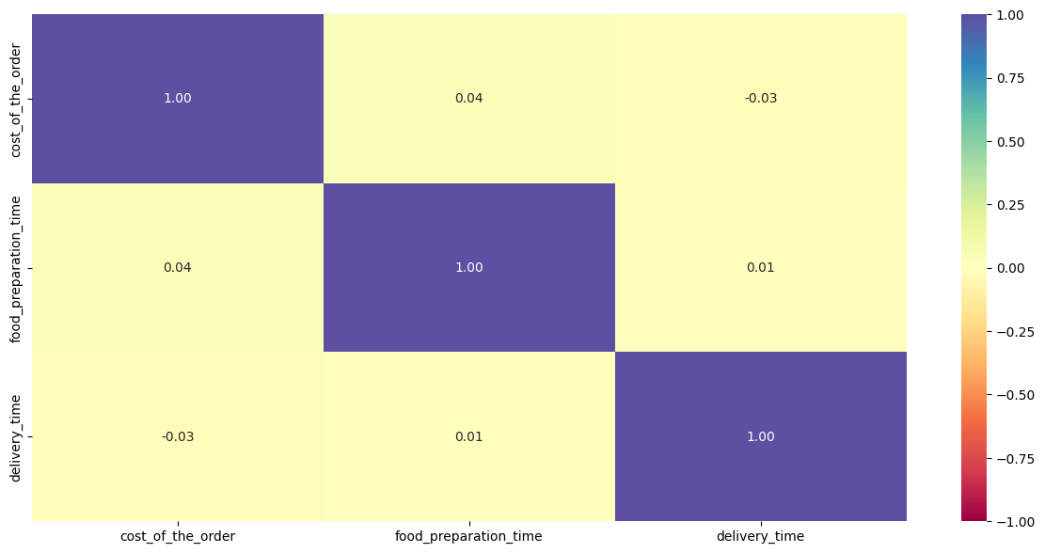
Multivariate Analysis
Correlation among variables
food preparation time and cost of the order have the highest correlation
delivery time and cost of the time have the lowest correlation

Slide 23
Multivariate Analysis
The company wants to provide a promotional offer in the advertisement of the restaurants. The condition to get the offer is that the restaurants must have a rating count of more than 50 and the average rating should be greater than 4. These restaurants will be:
Shake Shack
The Meatball Shop
Blue Ribbon Sushi
Blue Ribbon Fried Chicken

Slide 24
Multivariate Analysis
The company charges the restaurant 25% on the orders having cost greater than 20 dollars and 15% on the orders having cost greater than 5 dollars. The net revenue is around 6166.3 dollars
The percentage of orders that take more than 60 minutes to get delivered from the time the order is placed is 10.54%
The mean delivery time on weekdays is around 28 minutes
The mean delivery time on weekends is around 22.47 minutes

